Slide 1
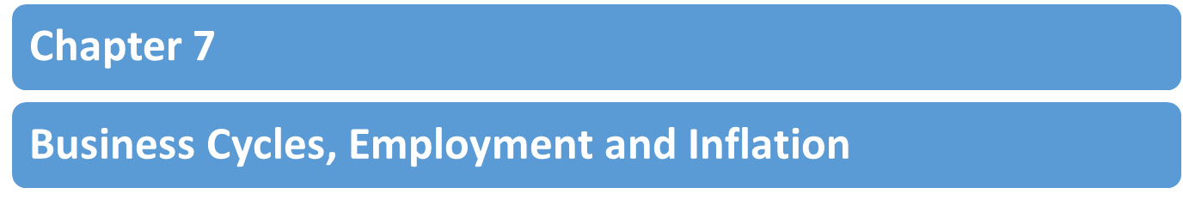
--Dr. Dowlah
--Fall 2016

Slide 2

A. Economic Growth (Stable and Higher growth rates)
B. Full Employment (keeping unemployment rate low)
C. Price Stability (Keeping Inflation Rate Low)
Dr. Dowlah/Fall2016

Slide 3
Economic growth is measured by changes in real Gross Domestic Product (GDP) –real national output/income of a country. Real GDP means it is adjusted for inflation.
Full Employment means the economy is at acceptable rate of unemployment. Full employment does not mean 0% unemployment.
Inflation refers to a sustained increase in the weighted price levels of all goods and services in an economy.
Dr. Dowlah/Fall2016

Slide 4

The theory of Business Cycles explains the pattern of economic growth rising and falling over the course of time.
The Business Cycle theory shows how macroeconomic goals—economic growth, employment and inflation—are affected during the various phases of business cycle.
Dr. Dowlah/Fall2016

Slide 5

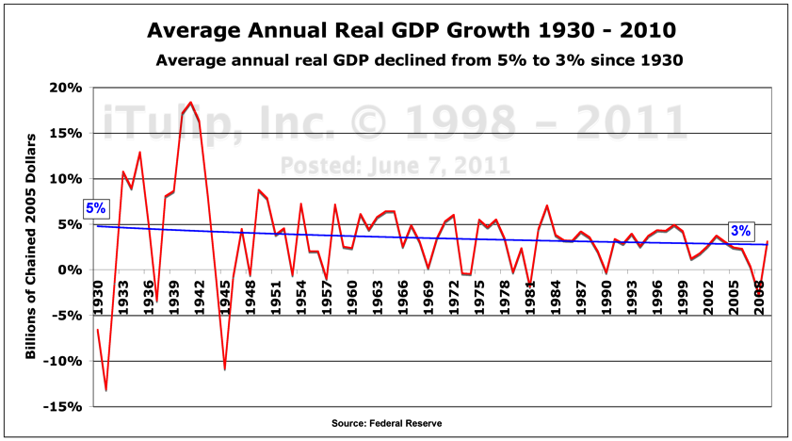
Dr. Dowlah/Fall2016

Slide 6
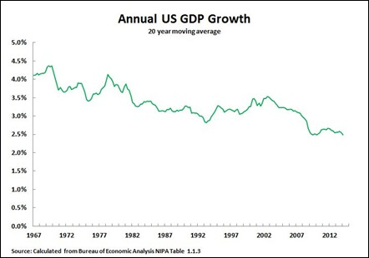

Slide 7

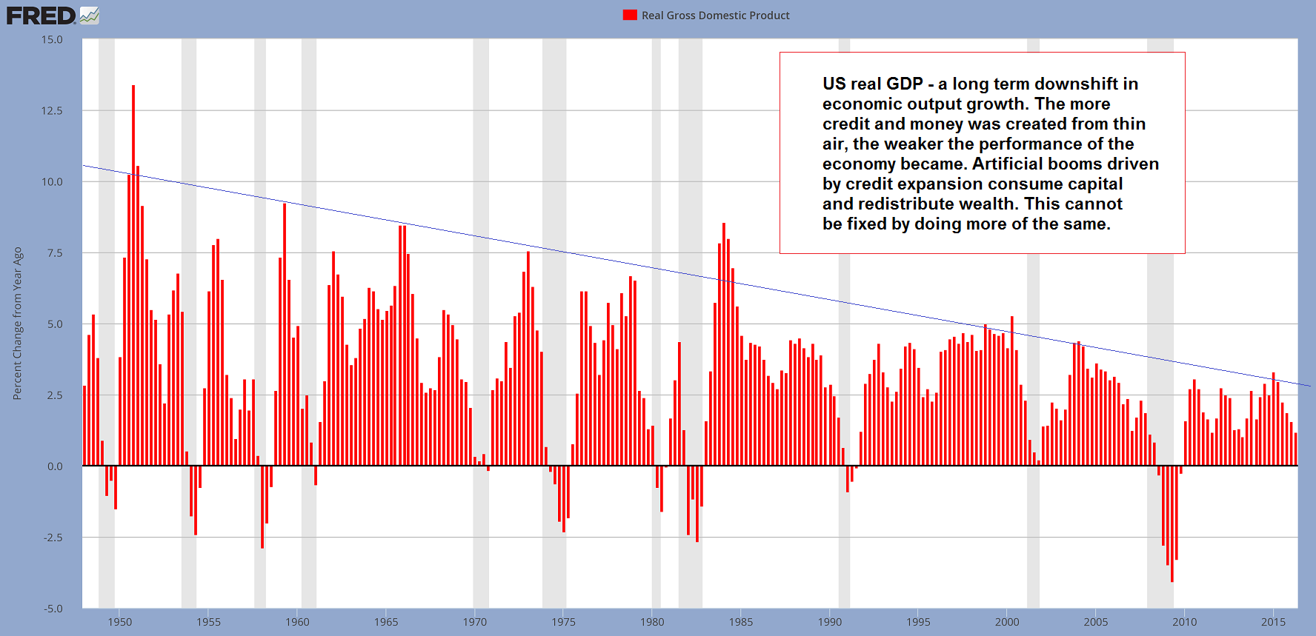

Slide 8
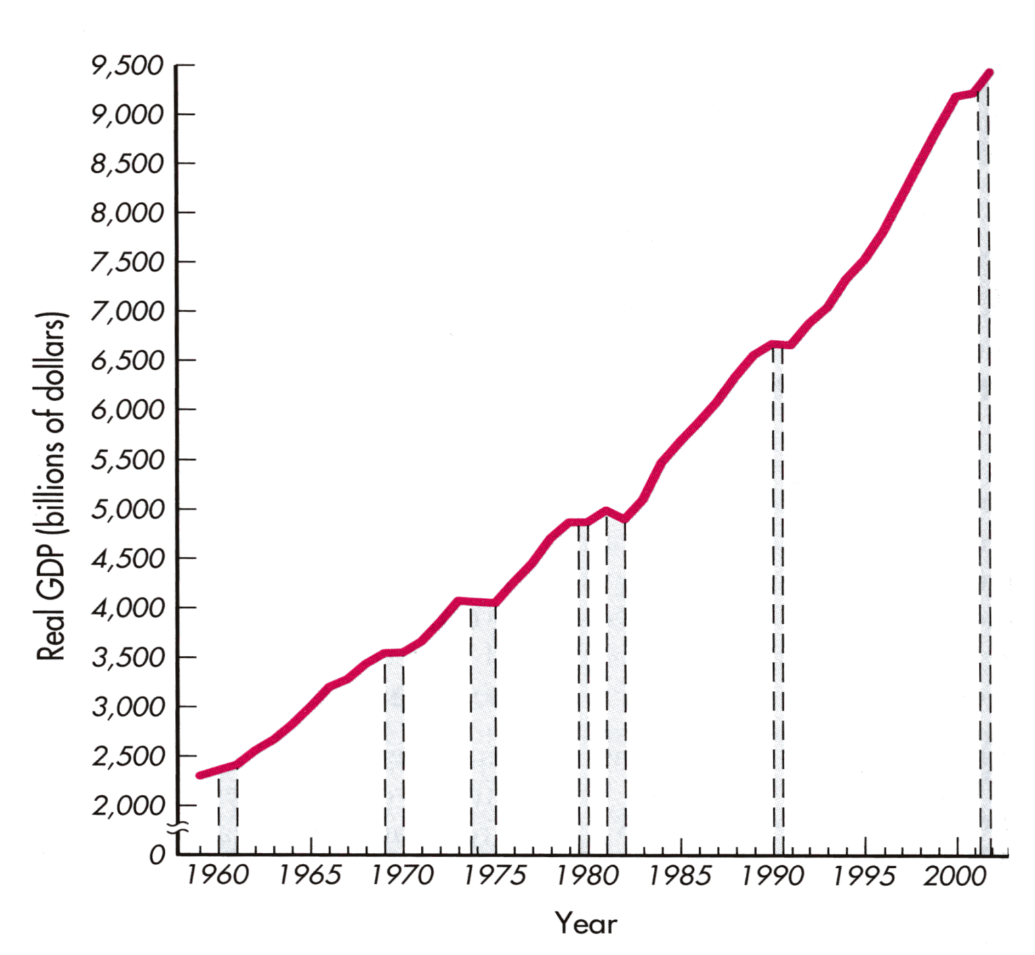
The Bumps Reflect Recessions
Dr. Dowlah/Fall2016

Slide 9

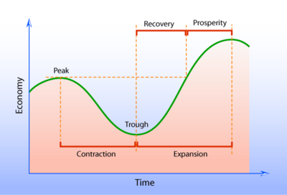
Dr. Dowlah/Fall2016

Slide 10

A. Peak: When economy reaches its possible highest point at a given point of time– unemployment falls, inflation rises,
and economic growth rises.
B. Contraction (recession)—when economic growth is negative— unemployment rising, inflation falling, and economic growth falling. Officially, the Economy will be considered in recession if GDP experiences negative growth for at least six consecutive months or two quarters.
Dr. Dowlah/Fall2016

Slide 11
C. Trough—when an economy reaches its bottom—can’t go down any more.
D. Expansion (recovery)—when economy picks up—moves away from trough— unemployment is falling, inflation rising , and economic growth rising
DEPRESSION: A severe, prolonged economic contraction. Usually involves unemployment rising to greater than 10% for several years in a row.
Dr. Dowlah/Fall2016

Slide 12
Year | U.S. Unemployment Rate
1929 | 3.2%
1930 | 8.7%
1931 | 15.9%
1932 | 23.6%
1933 | 24.9%
↓ | ↓
1939 | 17.2%
Dr. Dowlah/Fall2016

Slide 13
Between 1951 and 1999—the lowest was 2.8% in 1953, and the highest was 9.5% in 1982 and 1983.
During the last Great Recession (2007-2009), unemployment rose to 10% in October 2009.
Records of unemployment—the lowest during the World War II—around 2%.
The highest during the Great Depression—around 25%
Dr. Dowlah/Fall2016

Slide 14
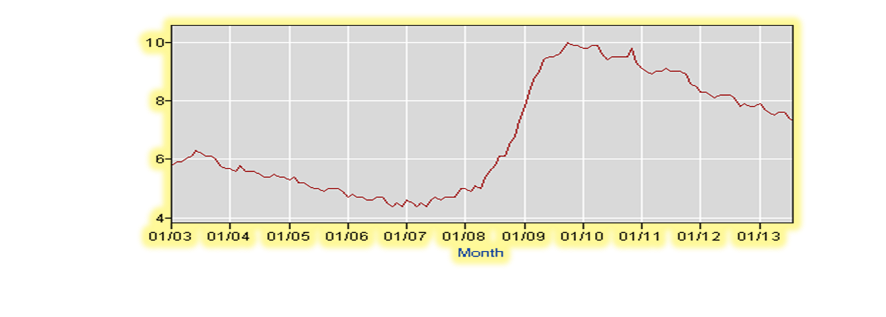
Dr. Dowlah/Fall2016

Slide 15
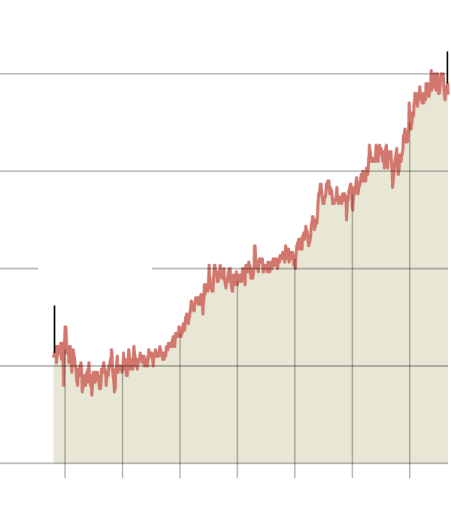
Percent of men, ages 25-54, who are outside the labor force (not employed and not seeking a job). 1950 through 2010.
Sept. 2016: 11:4% (7 million people adults). The rate was 3.3% in 1948.
Source: Bureau of Labor Statistics

Slide 16
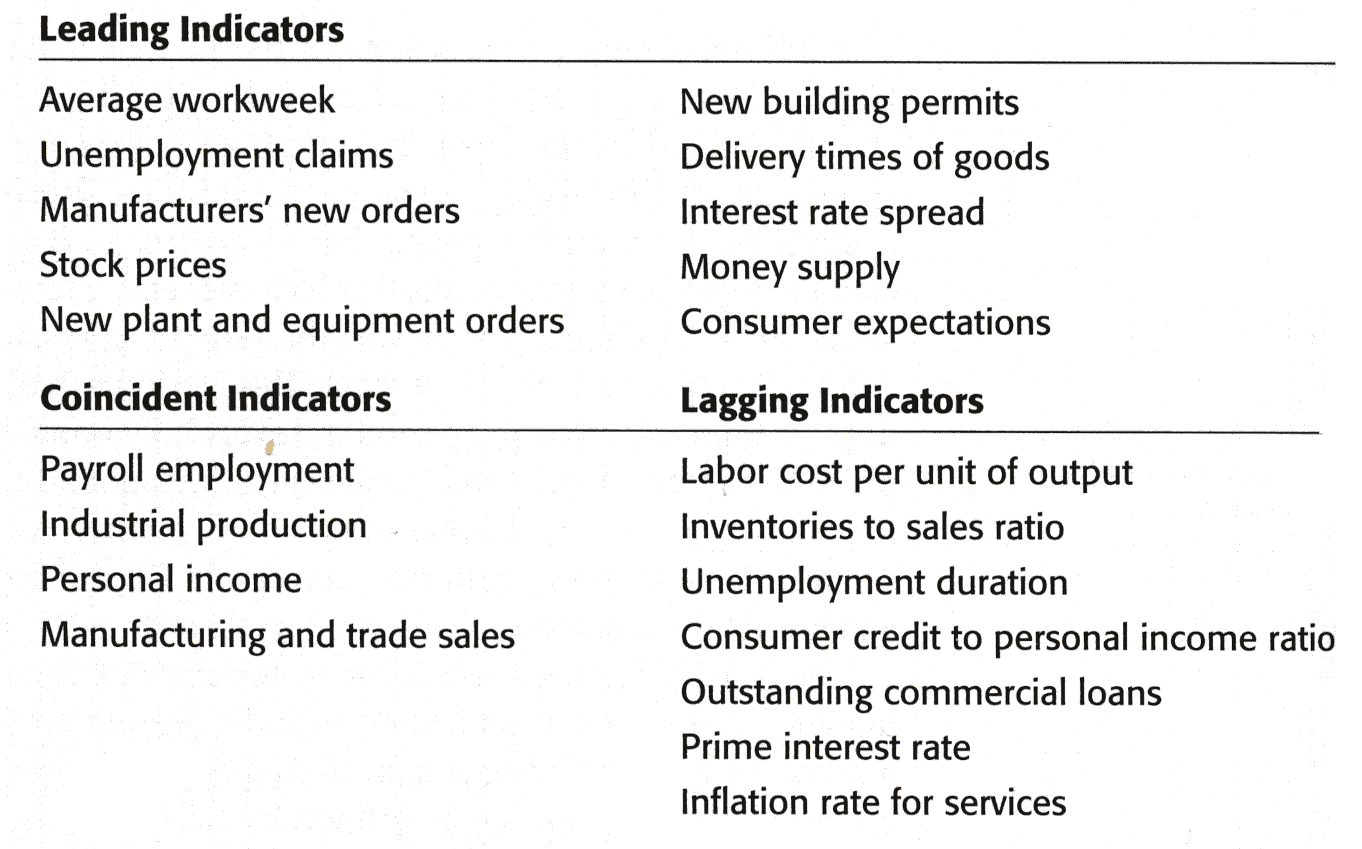
Dr. Dowlah/Fall2016

Slide 17
Employed—an adult who is working at least 1 hour a week for pay or at least 15 hours per week as a unpaid worker.
Unemployed—an adult—who is willing and able to work, and actively looking for job
Civilian Labor Force= Employed + Unemployed
Dr. Dowlah/Fall2016

Slide 18
Rate of
Unemployment
number of people unemployed
=
X 100
number of people in the Labor Force
Employment-population ratio= (Employed/Civilian Population) x 100
Dr. Dowlah/Fall2016

Slide 19
Among the major worker groups, the unemployment rate for:
Adult Men = 4.7 percent
Adult Women = 4.4 percent
Whites = 4.4 percent
Blacks = 8.3 percent
Hispanics = 6.4 percent
Asians = 3.9 percent
Teenagers = 15.8 percent
Dr. Dowlah/Fall2016

Slide 20
Civilian Population = 254.09 million
Civilian Labor Force = 159.91 million
Labor Force Participation Rate = 62.9%
Employed = 151.97 million
Employment-Population Ratio= 59.8%
Unemployed = 7.94 million
Not in Labor Force = 94.18 million.
Dr. Dowlah/Fall2016

Slide 21
Unemployment rate = (Number of adults unemployed/ Civilian Labor Force) x 100
= (7.94/159.91) x 100 = 4.96 = 5%
Labor Force Participation Rate = (Labor force/Civilian Adult population) x 100
=(159.91/254.09) x 100 = 62.9%
Employment-population ratio = (Employed /Civilian Adult Population) x 100
= (151.97/254.09) x 100 = 59.80%
Dr. Dowlah/Fall2016

Slide 22

Discouraged Workers are those workers who have looked for work in the past year, but who have stopped looking because they believe no one will offer them a job.
Underemployment is the employment of workers in jobs that do not utilize their full productive skills.
Dr. Dowlah/Fall2016

Slide 23
A. Seasonal Unemployment
  A product of regular, recurring changes in the hiring needs of certain industries on a monthly or seasonal basis.
B. Frictional Unemployment
  Occurs because workers and employers have to find one another. It is a product of the short-term movement of workers between jobs and careers, and of those just entering the labor force.
Dr. Dowlah/Fall2016

Slide 24
C. Structural Unemployment--reflects an imperfect match-up of employee skills and the skill requirements of the available jobs. It is a product of technological change and other changes in the structure of the economy.
D. Cyclical Unemployment--a product of business cycle fluctuations. When there is a general downturn in business activity, cyclical unemployment increases.
Dr. Dowlah/Fall2016

Slide 25
Natural Rate of Unemployment : The level of unemployment that results when the rate of unemployment is normal, considering both frictional and structural factors.
Natural Rate of Unemployment is also known as Acceptable Rate of Unemployment.
Dr. Dowlah/Fall2016

Slide 26
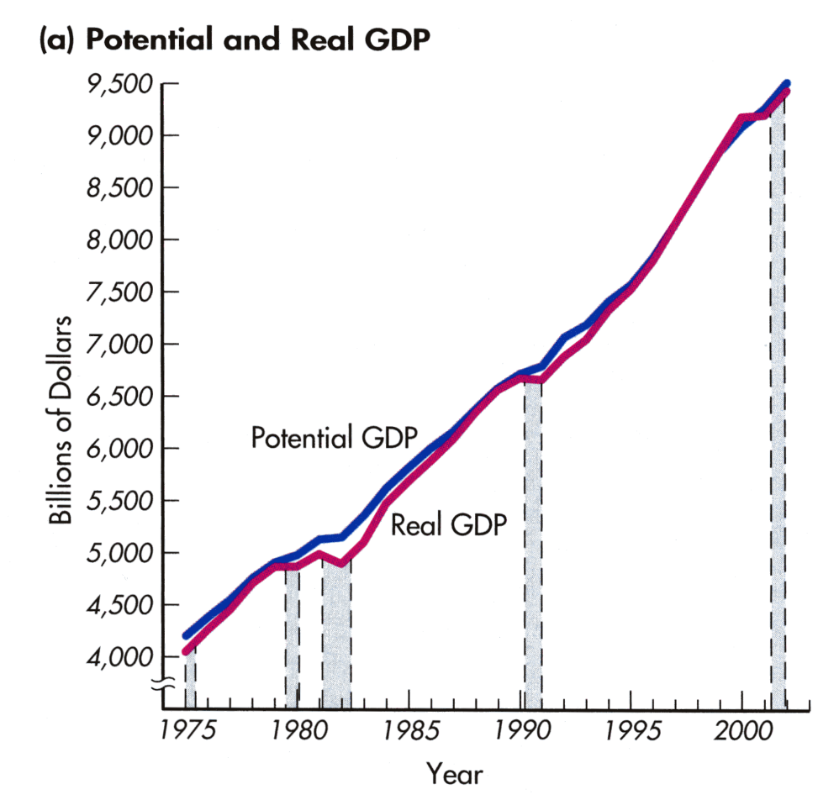
GDP GAP
Potential Real GDP—the level of output produced when non-labor resources are fully utilized and unemployment is at its natural rate.
GDP gap = potential real GDP – actual GDP
Dr. Dowlah/Fall2016

Slide 27

Inflation refers to a sustained increase in cost of living—it reflects in higher price levels throughout the economy.
The inflation rate is the percentage change in the price level since the previous period.
Dr. Dowlah/Fall2016

Slide 28
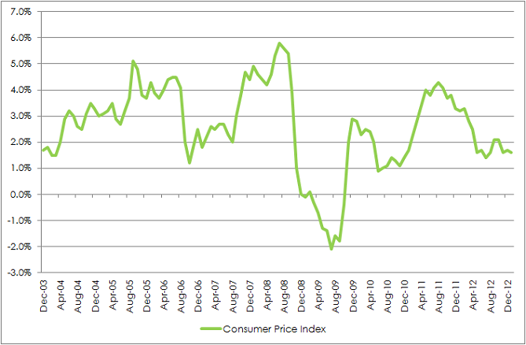
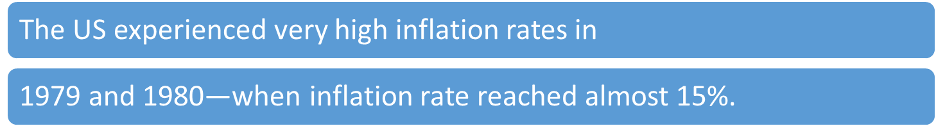
Dr. Dowlah/Fall2016

Slide 29

A. The consumer price index (CPI) shows the cost of a basket of goods and services relative to the cost of the same basket in the base year. The percentage change in the CPI measures the inflation rate.
B. The Producer Price Index (PPI) shows the cost of goods and services used by producers.
C. GDP Deflator shows the changes in price level of entire economy
Dr. Dowlah/Fall2016

Slide 30
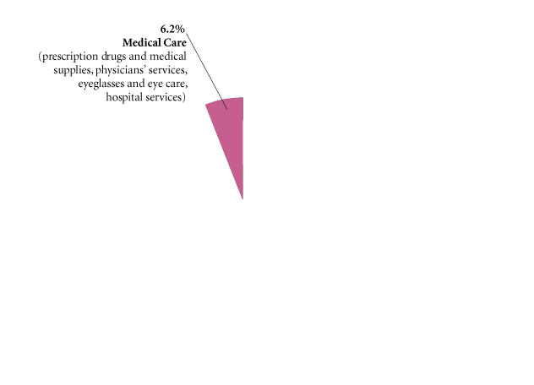
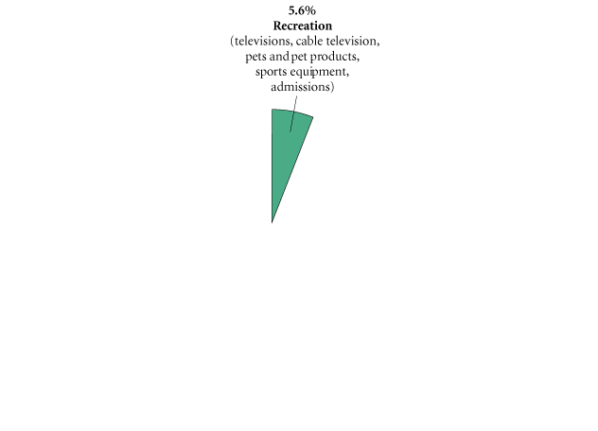
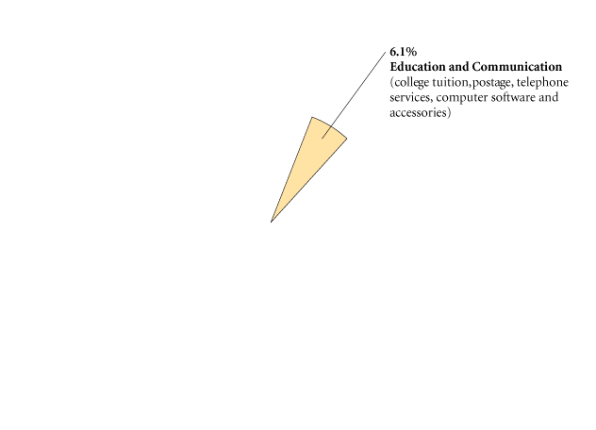
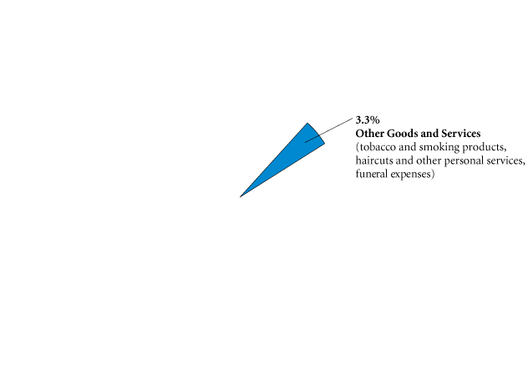
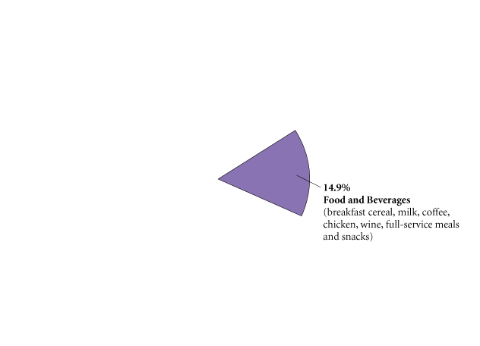
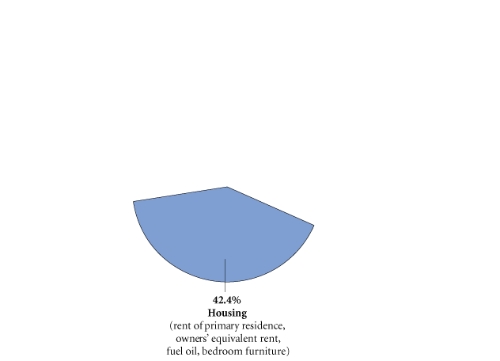
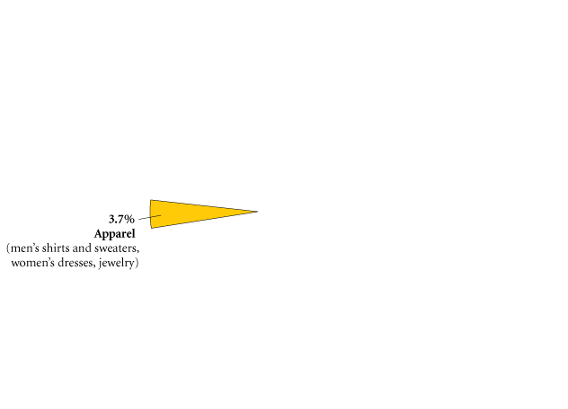
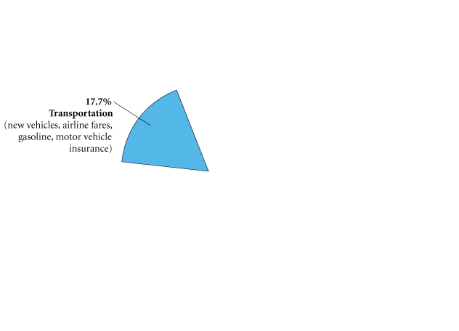
The CPI market basket shows how a typical consumer divides his or her money among various goods and services. Most of a consumer’s money goes toward housing, transportation, and food and beverages.
Source: The Bureau of Labor Statistics

Slide 31

The Bureau of Labor Statistics calculates the CPI each month on the basis of changes in price level of goods and services a typical consumer buys to help monitor the changes in the cost of living.
An increase in CPI means, cost of living has increased, and a drop in CPI means, cost of living has fallen. In other words, when CPI goes up, a typical consumer has to spend more to maintain the same level of living standard.
Dr. Dowlah/Fall2016

Slide 32
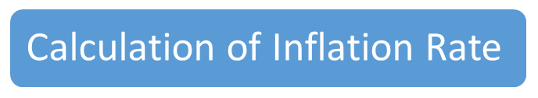
CPI= [(Current Year’s Cost of the market basket/Base Year’s Cost of the same market basket)] x 100
Inflation Rate= [(CPI in year 2- CPI in year 1)/CPI in Year 1] x 100
Dr. Dowlah/Fall2016

Slide 33
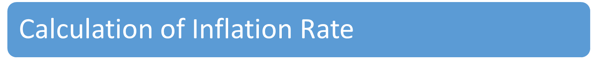
Inflation rate is the percentage change in price levels in period 2 compared with period 1.
The two periods, if they are years, can be described as base year and current year.
If you compare price levels of 2008 with that of 2007, then 2008 is the current year, and 2007 is the base year.
Dr. Dowlah/Fall2016

Slide 34
Calculation of CPI
Suppose your market basket consists of two goods: 4 Coffees and 2 Donuts
Year | Quantity of Coffee | Price of Coffee | Quantity of Donut | Price of Donut
2010 | 4 | $1.00 | 2 | $2
2011 | 4 | $2.00 | 2 | $3
Step 1: Calculate the cost of the market basket in each year
Cost of 2010 (base year) = (4 x $1.00) + (2 x $2.00) = $8.00
Cost of 2011 (current year) = (4 x $2.00) + (2 x $3.00) = $14.00
Step 2: Calculate CPI
CPI= [(Current Year’s Cost of the market basket/Base Year’s Cost of the same market basket)] x 100 = [($14.00 / $8.00] x 100 = 175
Step 3: Calculate Inflation Rate
Inflation Rate = [(CPI in year 2 - CPI in year 1)/CPI in Year 1] x 100
= [(175 -100)/100] x 100 = 75%

